Slide 1
Exploring Venues in Vadodara, Gujarat, India

Slide 2
Why to explore venues ?
Whenever a person searches for a venue in a new city, they’re highly interested in the best places that the city has to offer.
The person might want to know how good a given restaurant is or the price range it falls under. This extra information would help decide which venue to choose amongst the many venues in the city.
Clustering venues based on price range and ratings will help customer make more accurate decision.
Also plotting maps will help any visitor take quick glance and decide what place to visit.

Slide 3
Data acquisition and cleaning
To get location and other information about various venues in Vadodara, I used two APIs and decided to combine the data from both of them together.
Using the Foursquare’s explore API (which gives venues recommendations), I fetched venues up to a range of 4 kilometers from the center of Vadodara and collected their names, categories and locations (latitude and longitude).
Using the name, latitude and longitude values, I used the Zomato search API to fetch venues from its database. This API allows to find venues based on search criteria (usually the name), latitude and longitude values and more.
Given that the data from the two APIs did not align completely, I had to use data cleaning to combine the two datasets properly.
Final cleaned data consists of 45 venues and 8 columns(features).

Slide 4
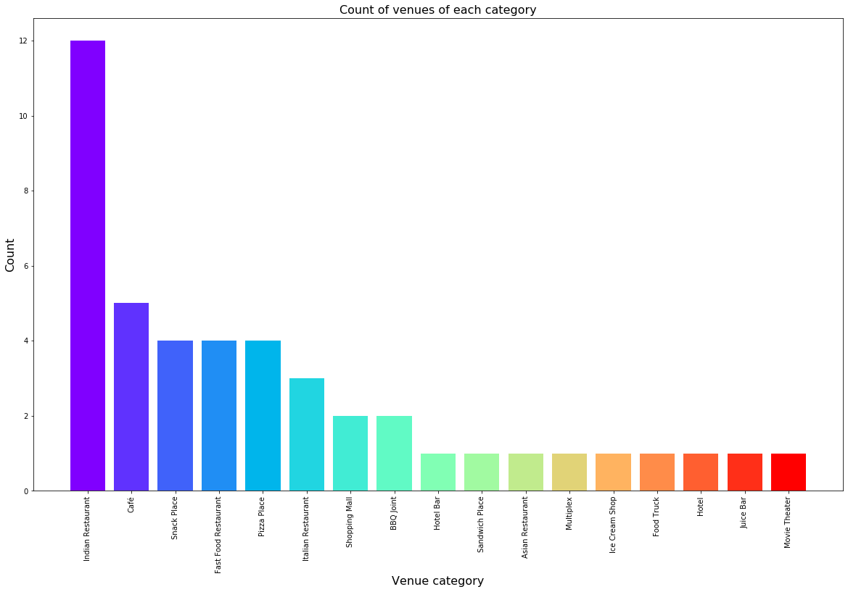
Count of various types of venues in Vadodara
We can see that majority
of venues fall under Indian restaurant
and Cafes.

Slide 5
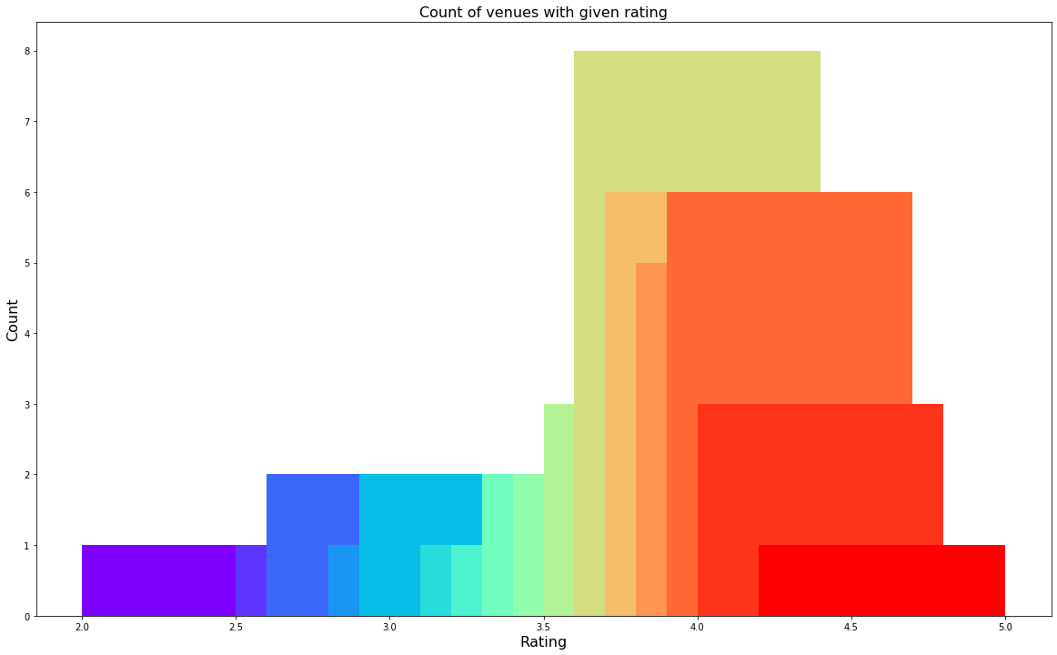
Rating and count of venues with that rating
Many restaurants fall between 3.5 to 4.5 ratings. So overall restaurants in Vadodara have good ratings.

Slide 6
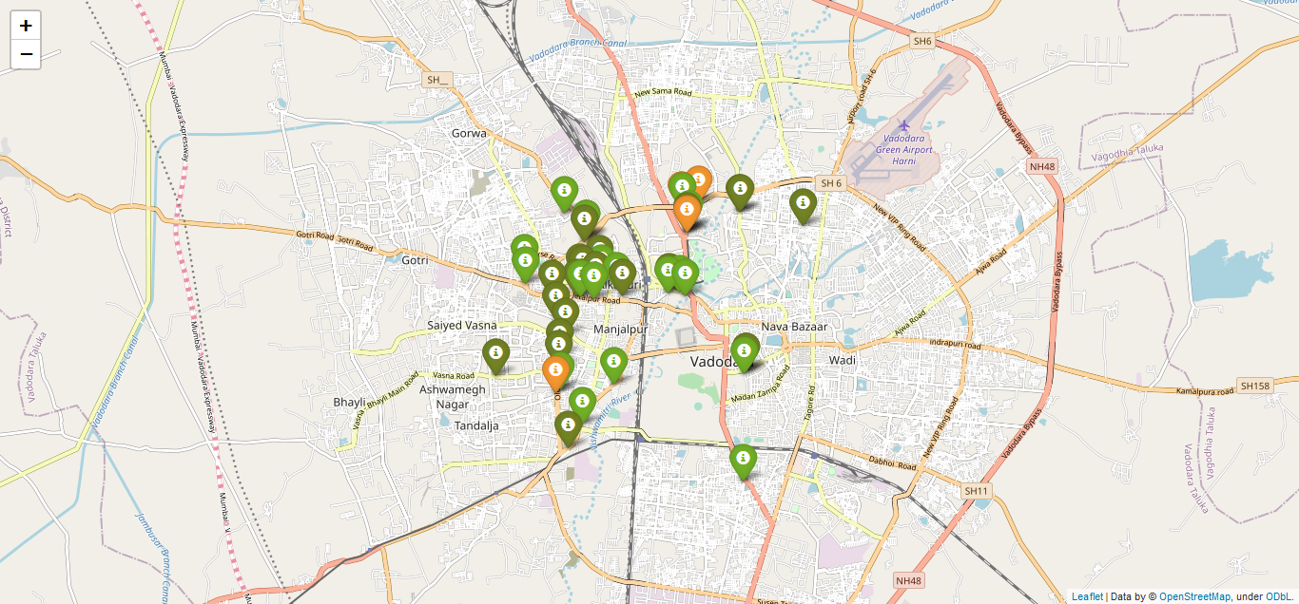
Plot of venues with different ratings

Slide 7
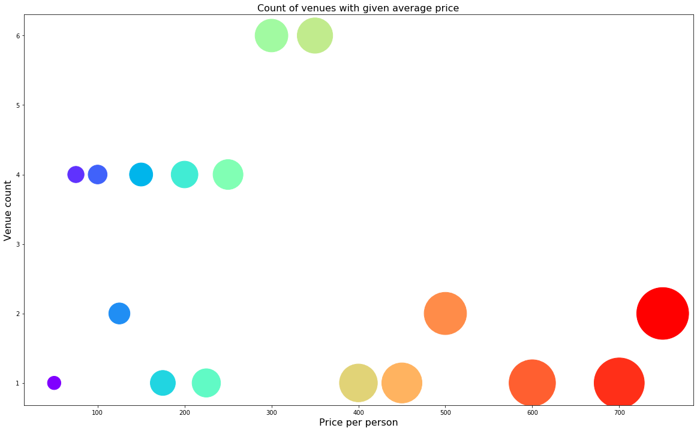
Price per person with count of venues with that price
From the graph we can conclude that many restaurants have price between 200 – 300 per person

Slide 8
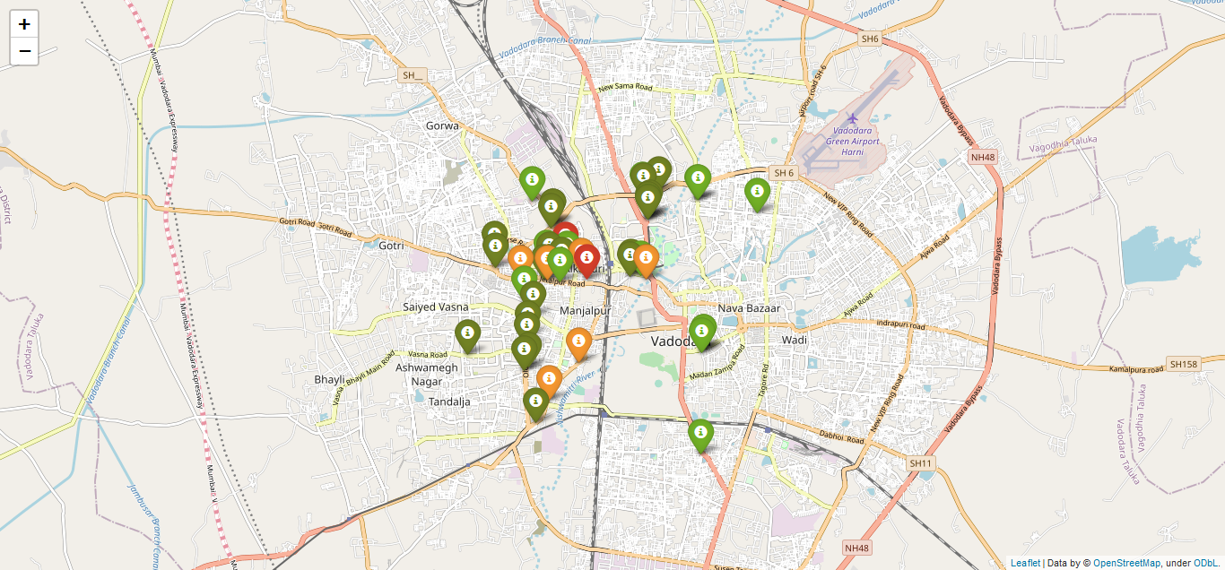
Plot of venues with different prices
From the plot, we observe that venues near Tandalja and Navabazar are primarily lower priced. The venues near Alkapuri and Manjalpur have high prices.

Slide 9
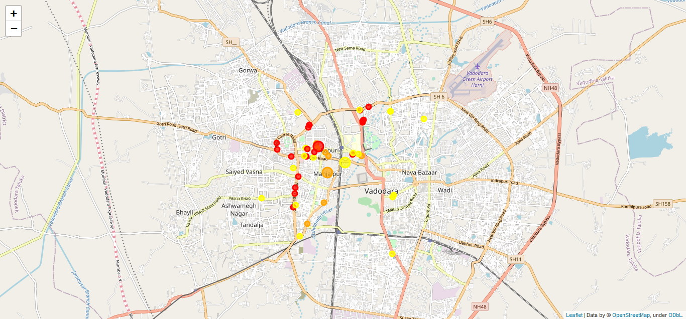
After Clustering Venues
In figure, we see the three clusters :
The first cluster (yellow) is spread across the whole city and includes the majority venues. These venues have mean price range of 1.25 and rating around 4.01.
The second cluster (orange) is very sparsely spread and has very limited venues. These venues have mean price range of 3.33 and rating around 3.93.
The third cluster (red) is mediumly spread across the city
and has mean price range of 2.11 and rating around 3.81.

Slide 10
Conclusion and future directions
The purpose of this project was to explore the places that a person visiting Vadodara could explore. The venues have been identified using Foursquare and Zomato API and have been plotted on the map.
The map reveals that there are three major areas a person can visit: Tandalja, Manjalpur and Alkapuri. Based on the visitor’s venue rating and price preferences, he/she can choose amongst the three places.
If you're looking for cheap places with relatively high rating, you should check Manjalpur.
If you're looking for the best places, with the highest rating but might also carry a high price tag, you should visit Alkapuri.
If you're looking to explore the city and have no specific criteria to decide upon the places you want to visit, you should try between Manjalpur and Alkapuri.

